Slide 1
Stroke Prediction Using Machine Learning
19CCE213 Machine Learning and Artificial Learning
Bachelor of Technology, Computer and Communication Engineering
2021 – 2025 Batch

Slide 2
Objective
The main objective for doing this research is to present a Stroke prediction model for the prediction of the occurrence of Stroke.
Further, this research work is aimed towards identifying the best classification algorithm for identifying the possibility of stroke in a patient.
It is justified by performing a comparative study and analysis using classification algorithms namely Logistic Regression, Support Vector Machine (SVM), K-Nearest Neighbour (KNN), Naïve Bayes, Random Forest and Decision Tree are used at different levels of evaluation.
Although these are commonly used machine learning algorithms, stroke prediction is a vital task involving the highest possible accuracy.
The work proposed in this paper focuses mainly on various data mining practices that are employed in Stroke prediction.
The main goal of this paper is to provide a tool for doctors to detect Stroke at an early stage.

Slide 3
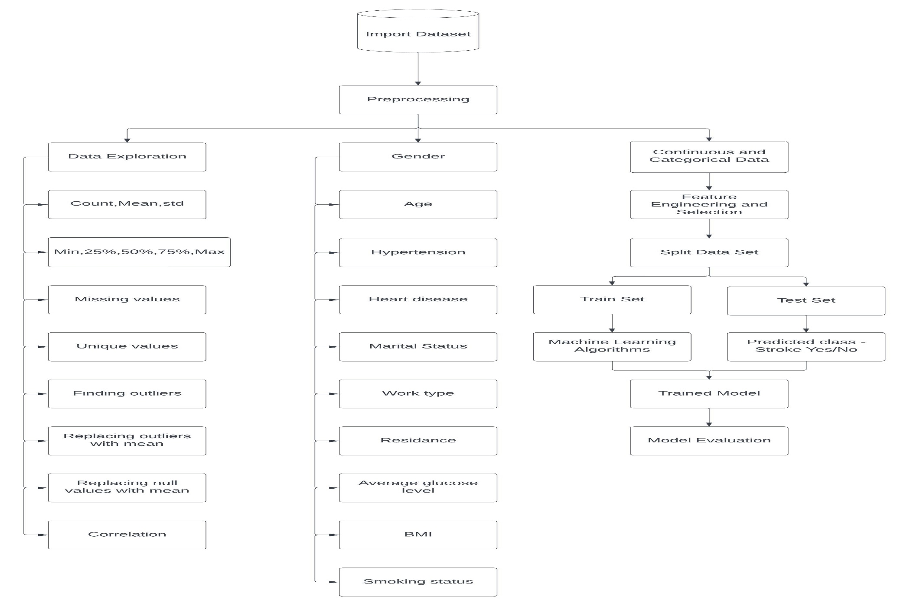
Methodology

Slide 4
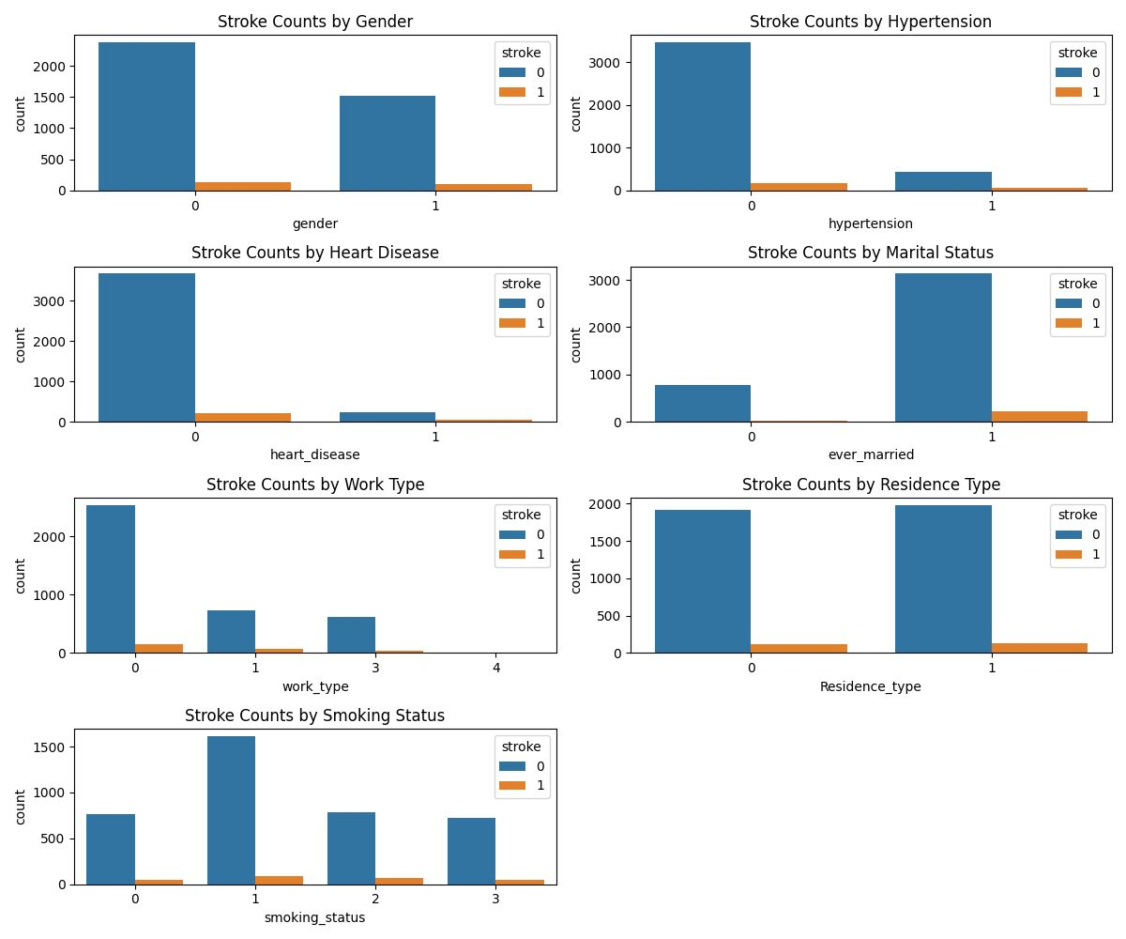
Complete Description of Categorical Data

Slide 5
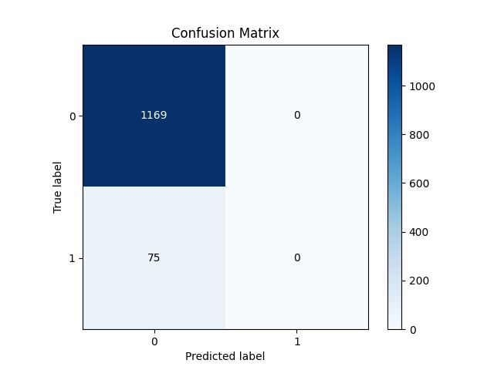
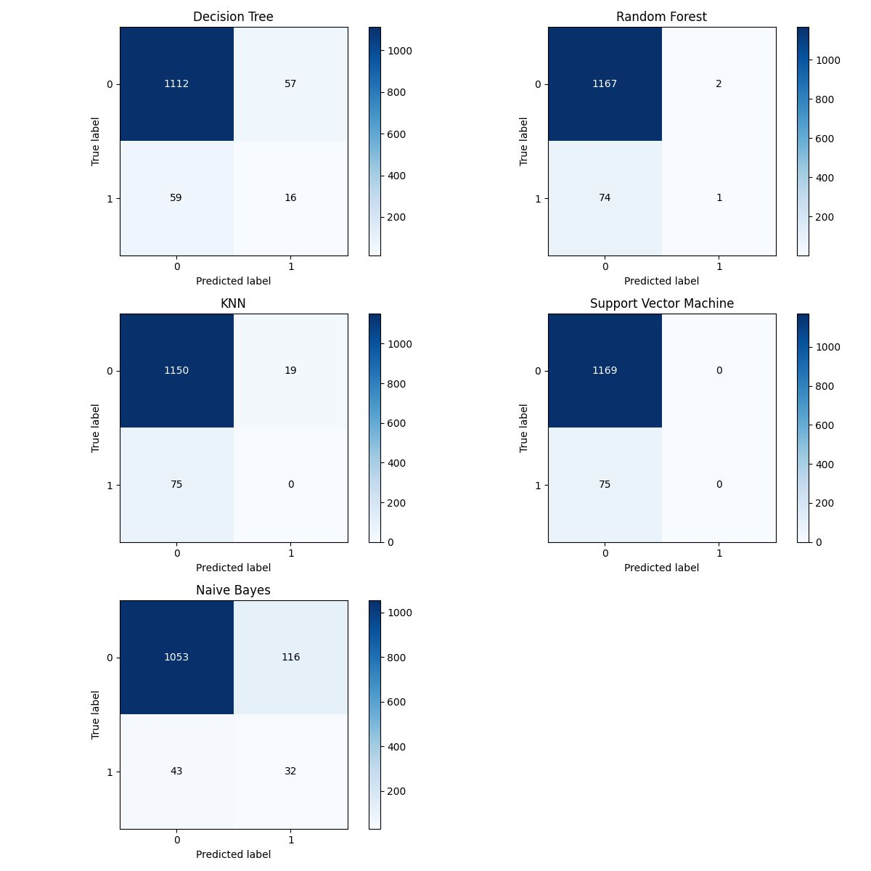
Classification

Slide 6
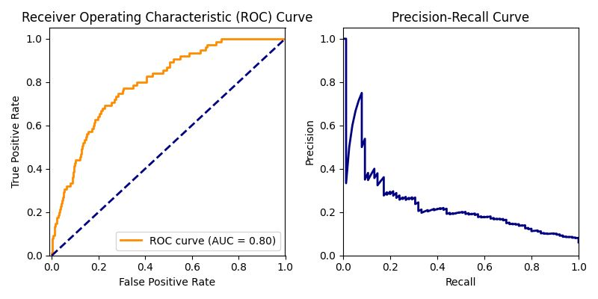
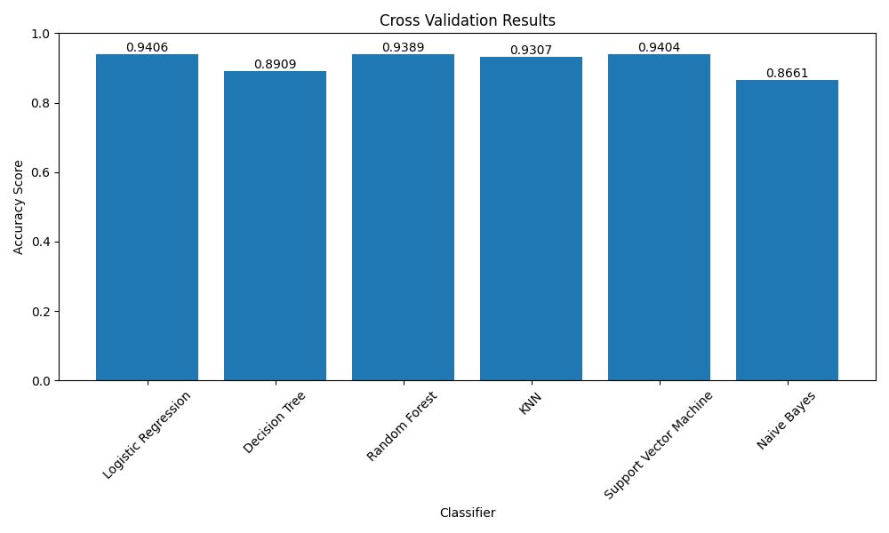
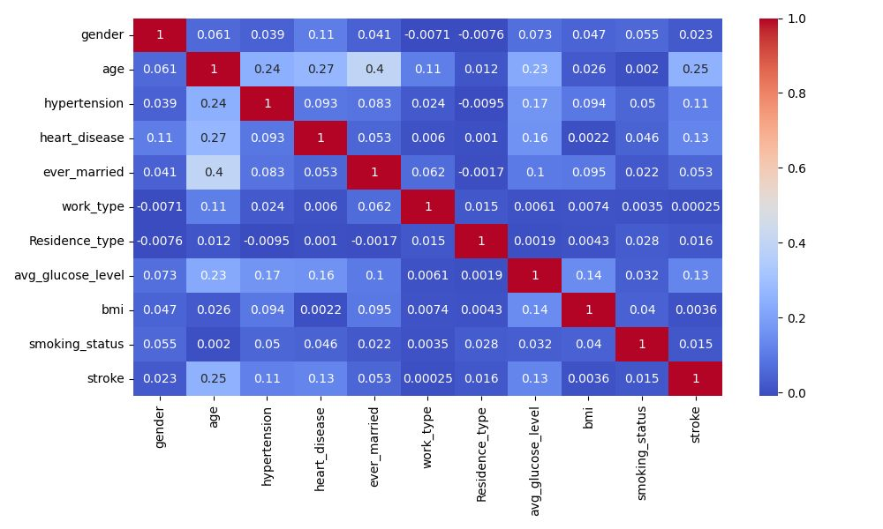
Results

Slide 7
Conclusion
With the increasing number of deaths due to stroke, it has almost become increasingly mandatory to develop a proficient system to predict stroke effectively and accurately.
This study compares the accuracy score of Logistic Regression, K-Nearest Neighbor (KNN), Naïve Bayes Classifier, Random Forest, Support Vector Machine, and Decision Tree algorithms for predicting stroke disease using the dataset.
Support Vector Machine(SVM)[94.03%] and Logistic Regression[94.06%] accuracy scores are almost same but when it comes to handling of large dataset Logistic Regression is preferred.
The result of this study indicates that the Logistic Regression algorithm is the most efficient algorithm with an accuracy score of 94.06% for the prediction of stroke.
In the future, the work can be enhanced by developing a web application based on the Logistic Regression as well as using a larger dataset as compared to the one used in this analysis, which will help to provide better results and help health professionals in predicting the stroke effectively and efficiently.

